Slide 1
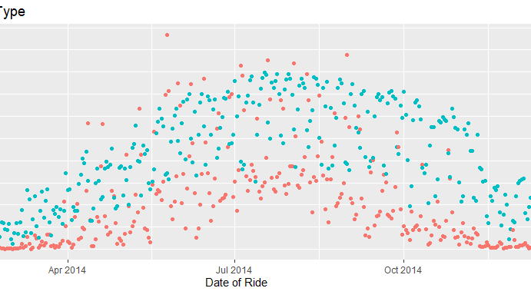


Cyclistic user analysis
August 25th, 2024
Google Analytics case study

Slide 2
Executive overview
Cyclistic supports its customers with 5,800 bicycles across 300 strategically placed locations in the Chicago Metropolitan Area
Riders are split into 2 categories, Subscription and Casual Riders
Casual Riders account for 32% of rides booked in 2024, but account for reduced possible profit vs. the Subscription model
Hypothesis: Properly targeted advertising can maximize the Subscription model yield and increase annual revenue
Research Goal: Identify key differences between Subscription and Casual rider behaviors to target user subgroups for marketing toward increasing Annual Subscriptions rates

Slide 3
Data journey
Overview:
Ride data was collected from 2024 Q1 through Q4
Station data was compiled from corresponding records
Source: Divvy-tripdata: Index of bucket "divvy-tripdata“
Note: Birth Year and Gender records were missing on a combined 32.2% of records, and therefore excluded from use in any conclusions at this time
Analysis was completed using Rstudio and Excel

Slide 4
User segments
Subscriber activity shows a clear decline on weekends, likely due to subscription model appealing to commuter customers
Non-Subscriber use correlates with weekend city exploration / use for fun or errands

Slide 5
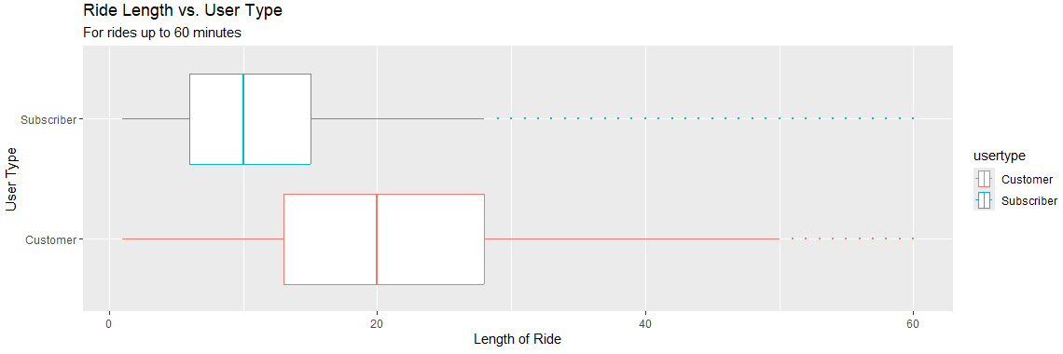
User segmentation
Rides up to 60 minutes account for 97.9% of business
31% of rides in 60 minute window are non Subscribers

Slide 6
Summary
Reasoning:
Non Subscriber rides show 20% + increase on weekends, with rides within 60 minute time frame
Successful use cases skew overwhelmingly to 60 minutes or less ride periods
Early Marketing Recommendations:
Advertisements could focus on ease of use vs other solutions, emphasize perks or sales from repeated use on weekends to encourage annual subscriptions
App platform could be used to emphasize CO2 / Carbon Footprint saved vs. same distance in rideshare / Uber style solution as Eco Friendly encouragement
Additional Data / Research Recommended:
Next research phase should identify specific station IDs with highest traffic for ad campaigns
Specific user tracking can solidify weekend vs. commuter hypothesis
Cost of Cyclistic program vs. other transport methods in local area

Slide 7
Appendix

Slide 8
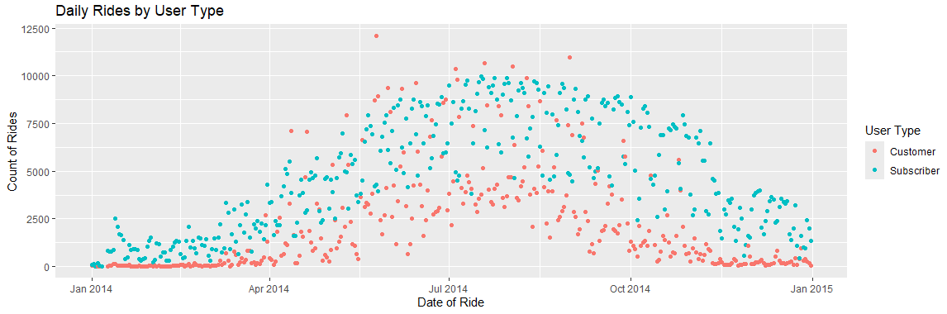
Rides per day by user type

Slide 9
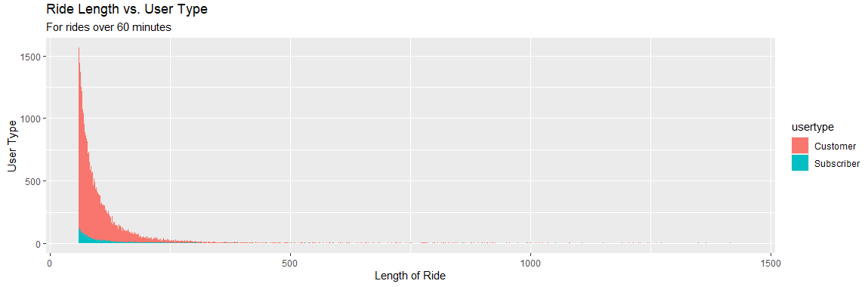
User type segmentation
Rides over 60 minutes clearly prioritized by non Subscribers, but only account for 2% of annual rides

